Slide 1


Testing
Nemanja Đorđević
Ivan Lazarević

Slide 2


Testing
What is test?
What types of tests exists?

Slide 3
Testing
Unit Testing (Component testing)
Integration Testing
System Testing -> Black box approach (performance, stress, security, reliability)
Acceptance Testing
…

Slide 4
Definition of Done
Programer | Testiranje / Deployment / DevOps
Kôd je pokriven sa unit testovima | Napisan je QA test plan
Unit testovi imaju minimum n% pokrivenosti kôda | Testiranje obavljeno po QA planu od strane drugo člana tima
Kôd je spojen (merge) u odgovarajuću source granu | Urađen deployment i testiranje u odgovarajućem okruženju (npr Staging)
Kôd se kompajlira i svi unit testovi su zeleni prilikom automatskog build-a | Automatski UI testovi su napisani i svi su prošli ok
Šema baze podataka i odgovarajuće skripte su pod surce control-om | Ne postoji ni jedan bug određenog kritičnog nivoa
Obavljen je pregled kôda od strane drugog člana tima | Pregledao product owner / projektni menadžer
 | Kriterijum za prihvatanje (Acceptance criteria) je prošao ok
 | Obavljeno load testiranje
... | ...

Slide 5
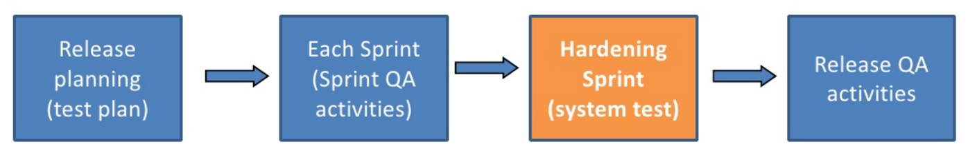
Testing in Agile

Slide 6
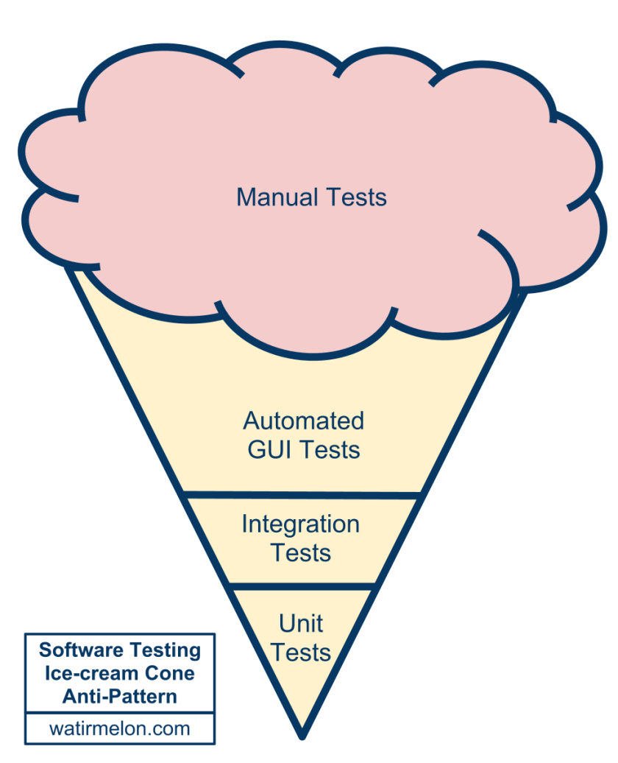
Ice-cream Cone Anti-pattern

Slide 7
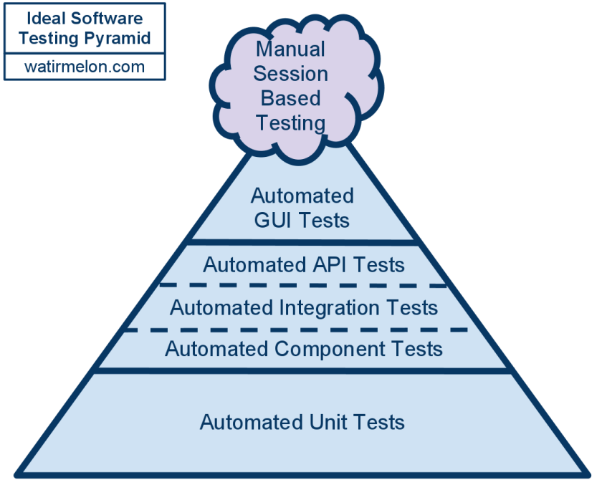
Ideal Software Testing Pyramid

Slide 8
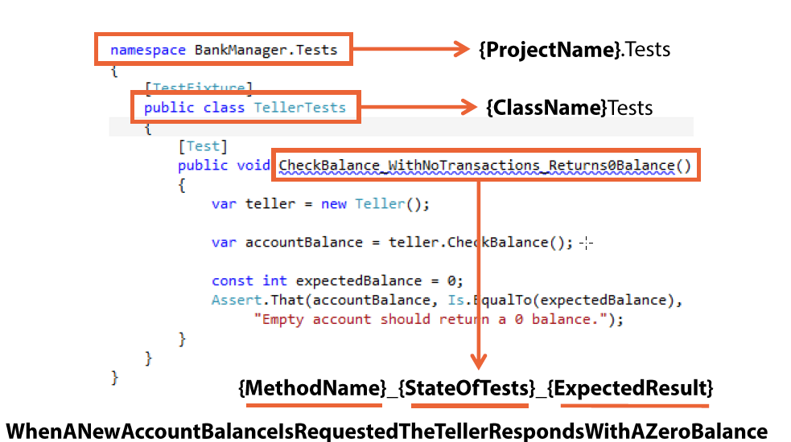
Unit test – naming convention

Slide 9


Unit test – naming convention
ToSerbianLatin_Test()
ToSerbianLatin_should_not_convert_special_charachters_or_numbers()
ToSerbianLatin_should_convert_serbian_cyrillic_charachters_to_serbian_latin_charachters()

Slide 10
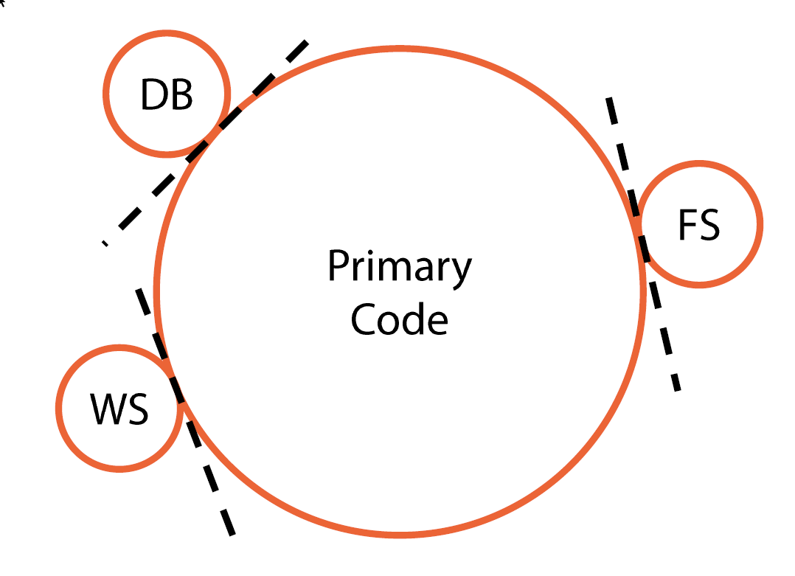
Seams

Slide 11
Fakes
Stub
Mock (use carefully, coupling test to implementation)
Double, Fake, Mock... (used interchangeably, things that are used to create isolation)
Interface or Virtual methods

Slide 12
Parametrized tests
[Theory]
[InlineData("")]
[InlineData(null)]
[InlineData(" ")]
public void When_path_to_manifest_file_is_not_set_throw_argument_null_exception(string path)
{
//arrange
var sut = new TestableManifestHelper();
//act
Exception ex = Assert.Throws<ArgumentNullException>(() => sut.ReadManifest(path));
//assert
…
}

Slide 13
Lab exercise assignment: ASP.NET Core Integration testing
https://docs.microsoft.com/en-us/aspnet/core/testing/integration-testing

Slide 14
Resources
Ian Cooper: TDD, where did it all go wrong - https://vimeo.com/68375232
J.B. Rainsberger - Integrated Tests Are A Scam - https://vimeo.com/80533536
The Art of unit testing in .NET, 2nd edition, manning
Advanced unit testing by Mark Seemann, pluralsight

Slide 15
Thank you for your attention

